Slide 1
ERASMUS+ Ka1 Staff Mobility LONDON 11-22 SEPTEMBER 2017
«A BETTER SCHOOL TO CHANGE OUR TERRITORY»

Slide 2
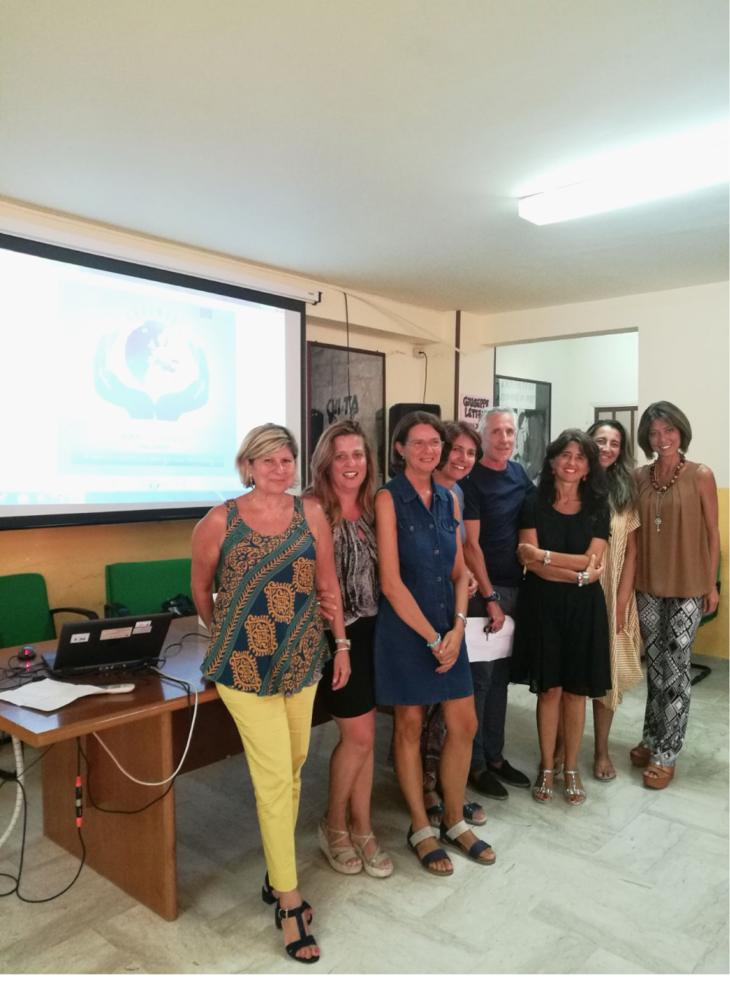
READY TO LEAVE
LONDON
Adriana butera,Monia camarda, Rina Carfì, Marisa cuffaro,Antonella Lepanto,Giovanni Parisi,Francesca Starrabba e Mariuccia Taddeo.

Slide 3
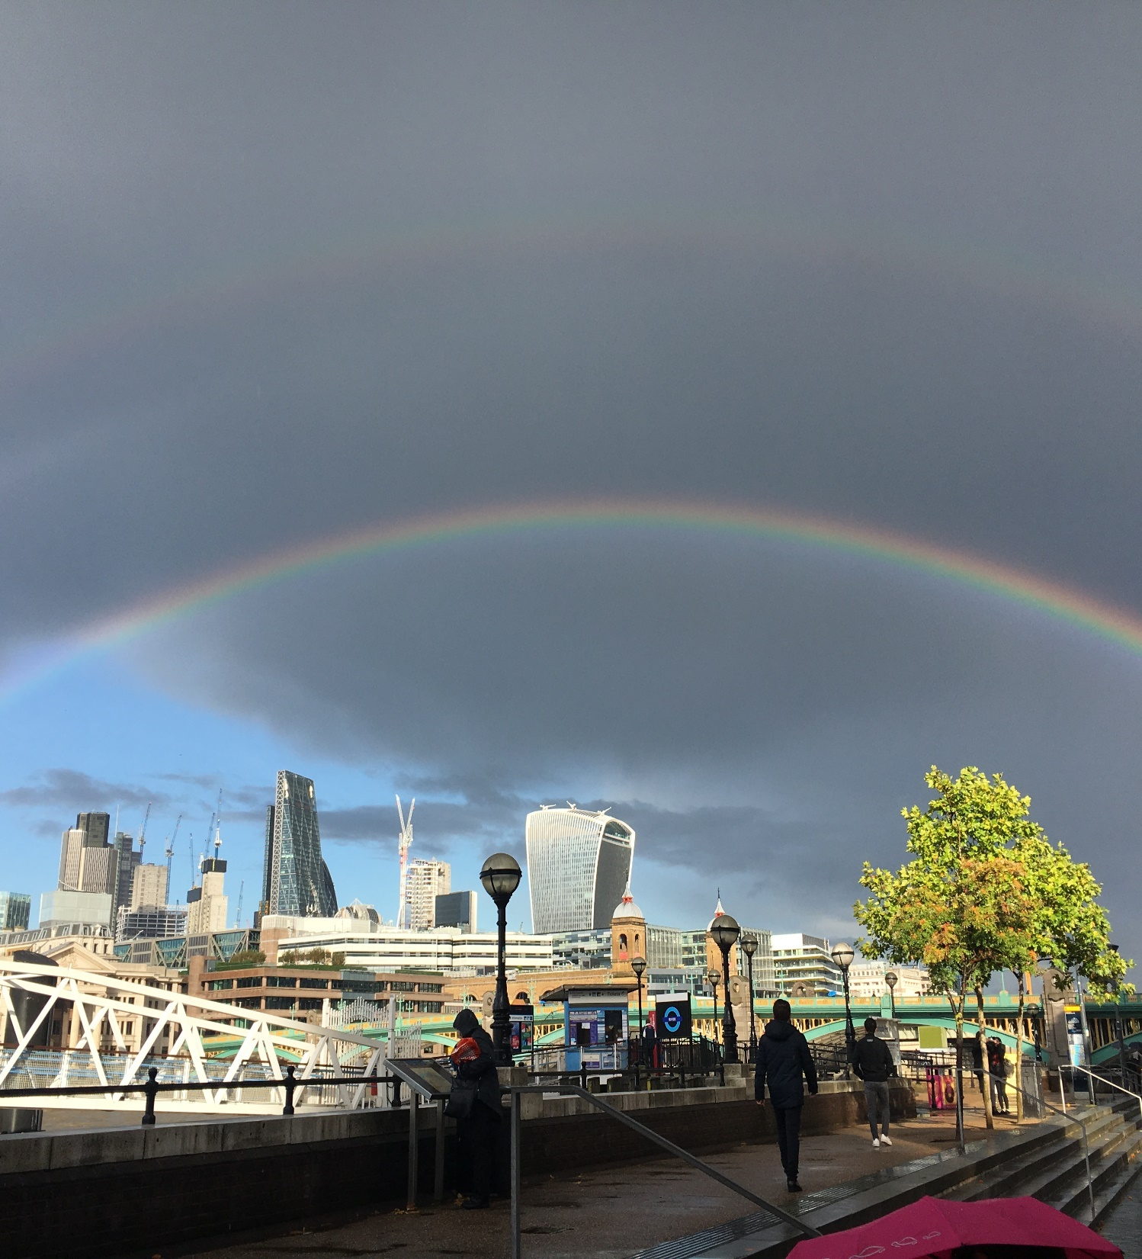
A MARVELLOUS SIGHT FROM THE TATE MODERN

Slide 4
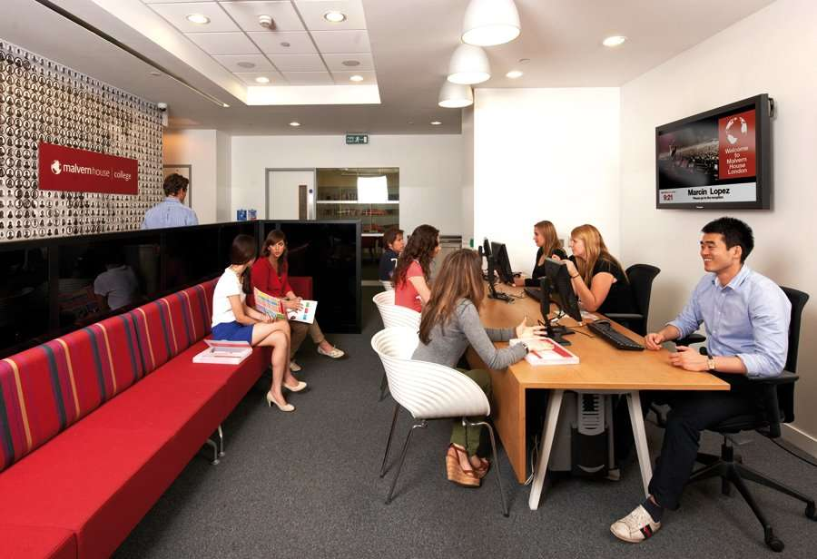
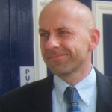
Malvern House is located in 200, Pentonville Road, near King’s Cross, one of the most popular railway and underground stations in London.
The school staff is kind, friendly and above all professional.
The Director Kris Hall introduced his staff and the course plan in a compelling way.

Slide 5
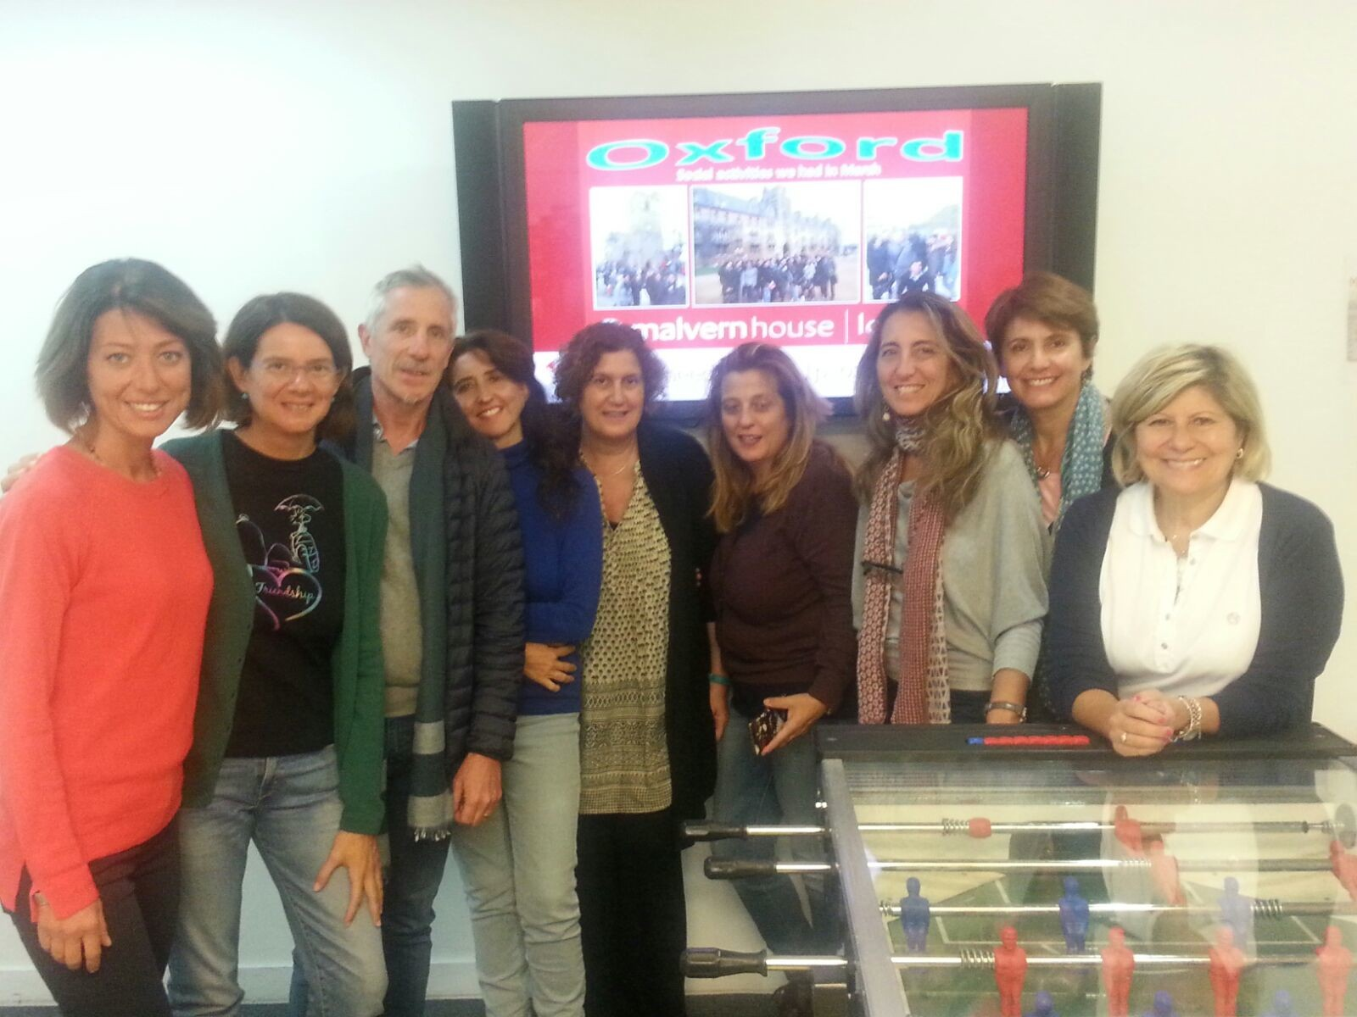
All together with our teacher Rachel Kirsch.
More than English: not only studying and learning but also sharing
and having fun!

Slide 6
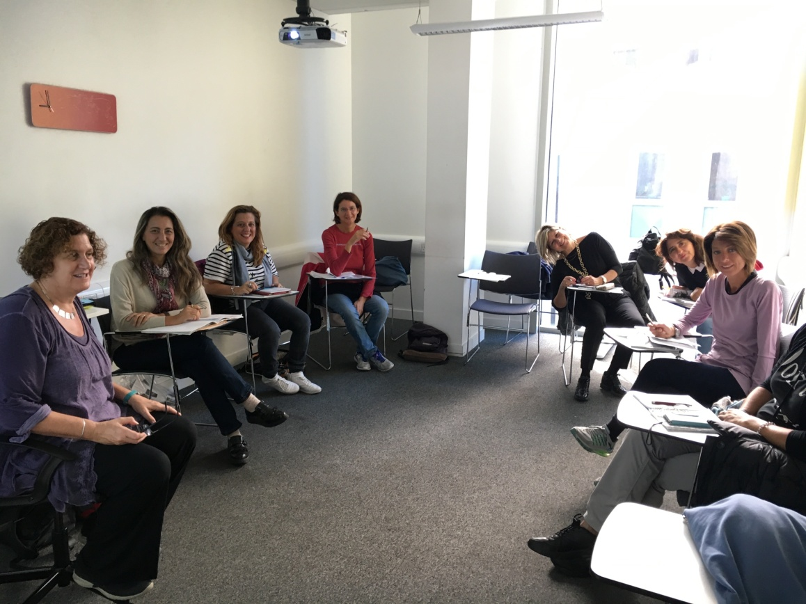
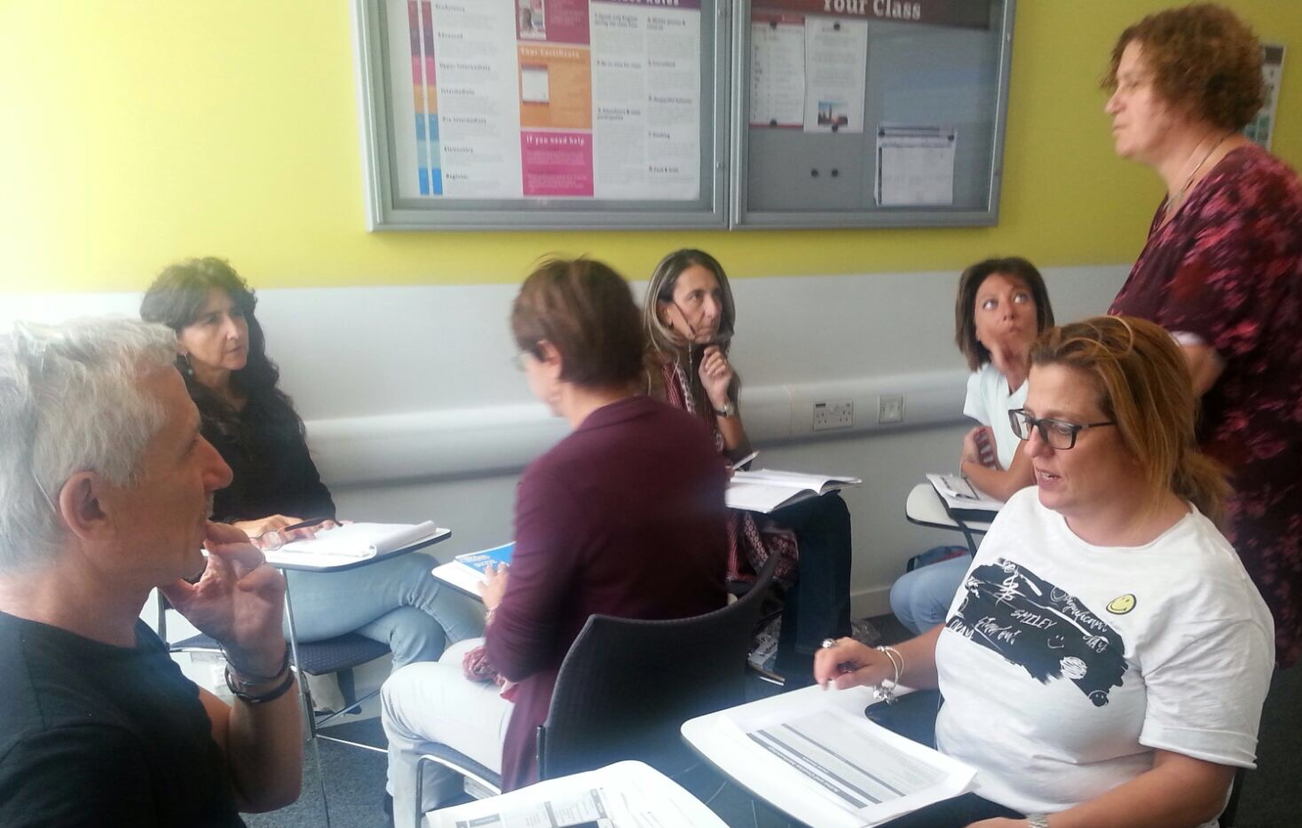
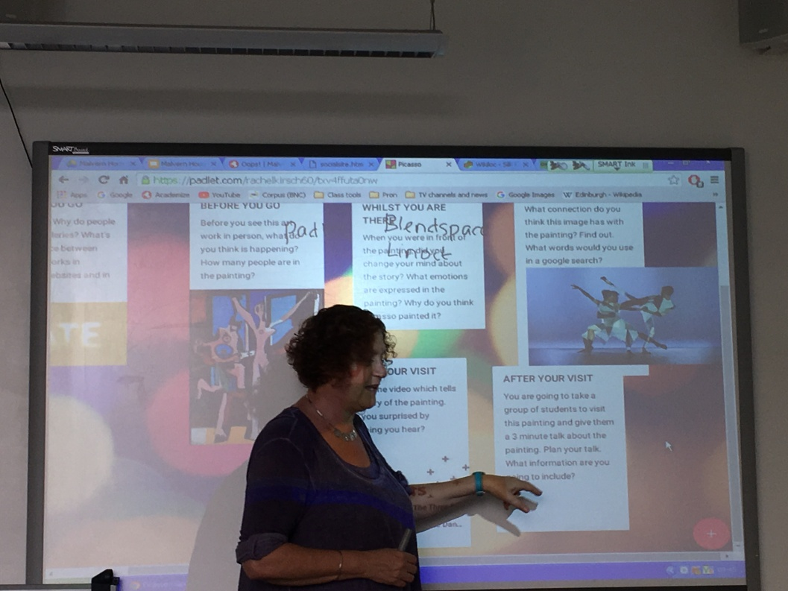
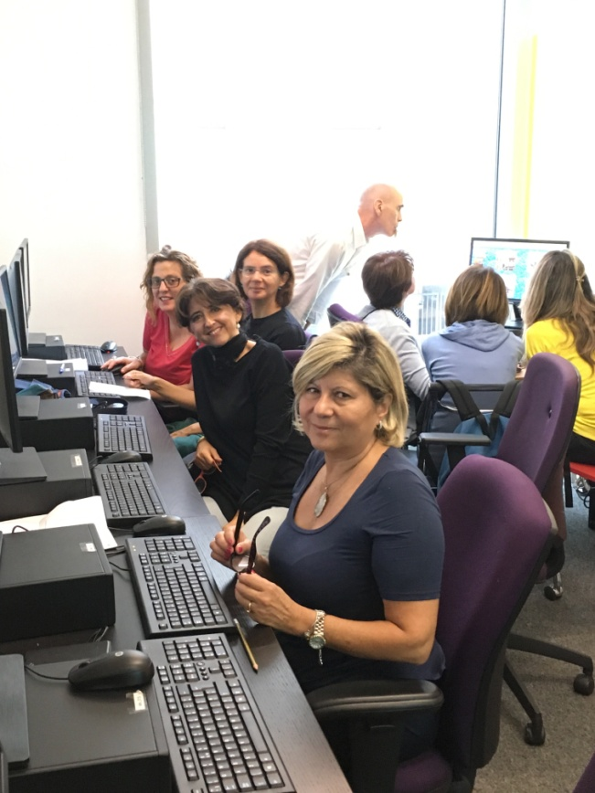
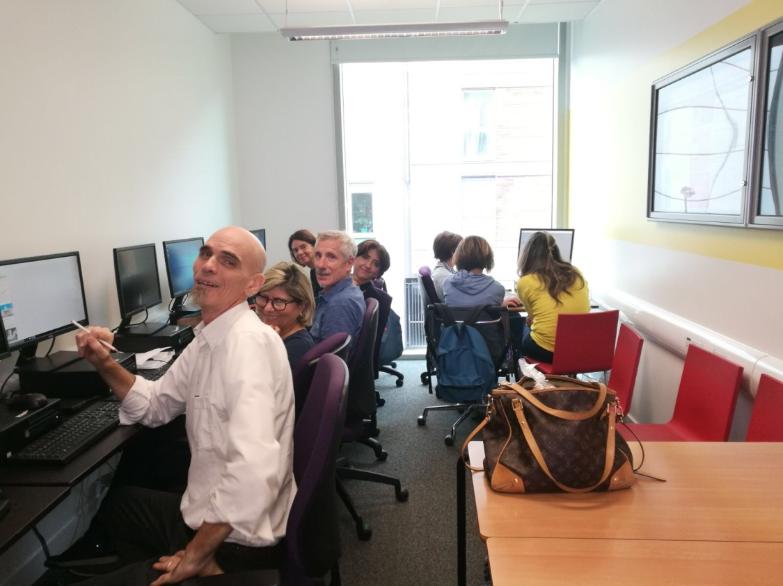
Interactive Pattern

Slide 7
Digital canvas
Linoit.com and Padlet.com
(to give information about a topic, to share information and resources)
Blendspace www.tes.com/lessons
Tes teach:create digital lessons in 5 minutes
(to bookmark links in one place to share with participants; to share lessons/links with strudents to be done at home)

Slide 8
Free online courses and userful Links
MOOC (massive open online courses)
Futurelearn.com
TED.COM
Breakingnewenglish.com
Onestopenglish.com

Slide 9
BYOD (Bring your own devices)
Fotobabble.com A cute, fun way to share and narrate
photos with friends ; create talking photos and slideshows.

Slide 10
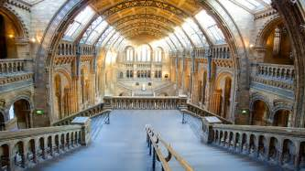
Museums Gathering ideas for a lesson to present the following day
British Museum
Natural History Museum

Slide 11
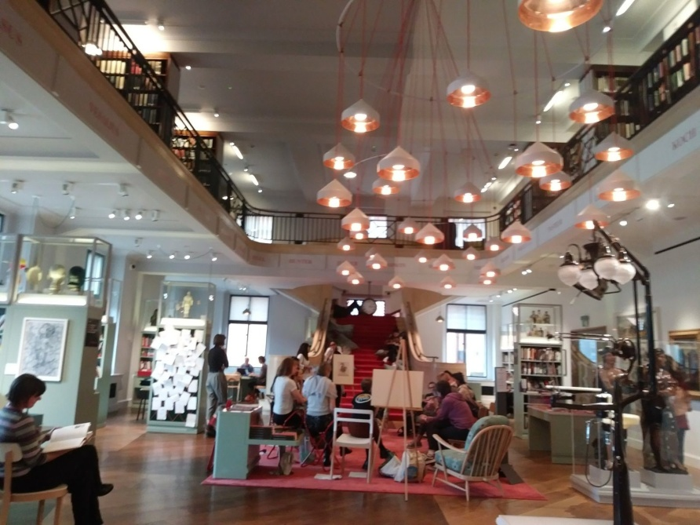
The Wellcome Collection and The National Gallery
During guided visits at the museums we practised suggestions and input received at school to get students involved before, whilst and after.
We tried some games and acticities for students like the treasure hunt.
The day after the visits we prepared some lesson plans,using different tools such as: linoit, padlet and blendspace.

Slide 12
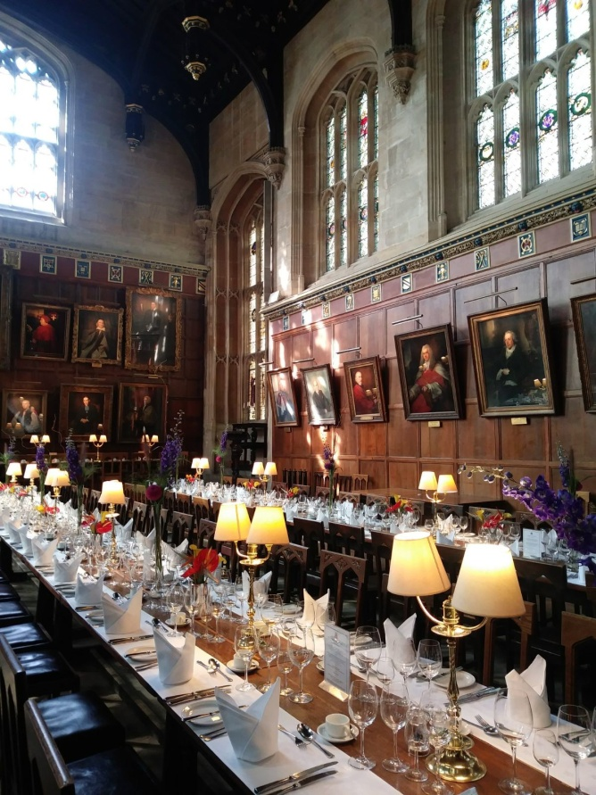
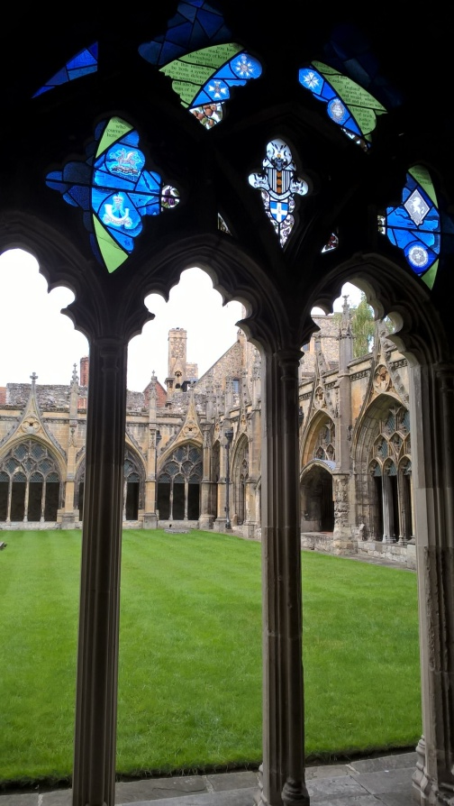
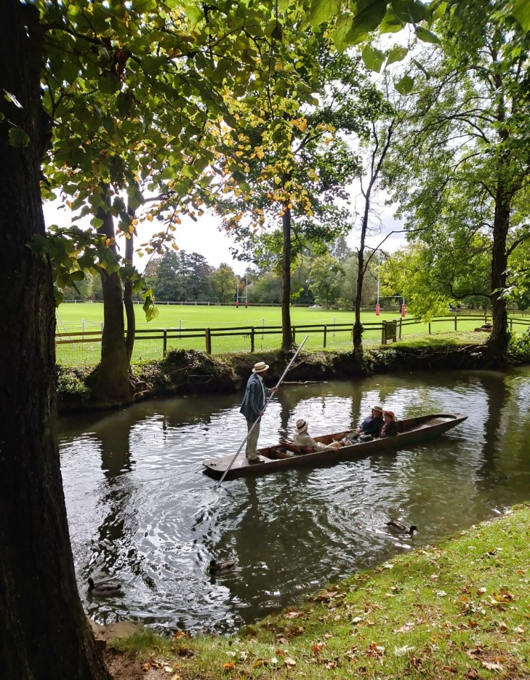
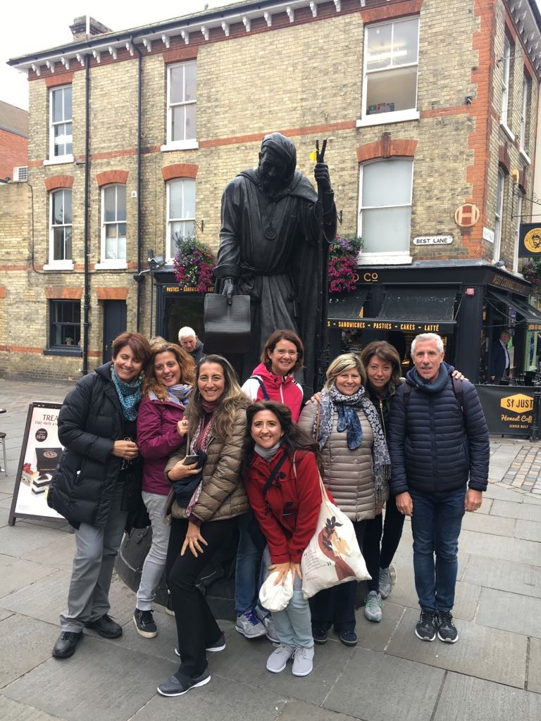
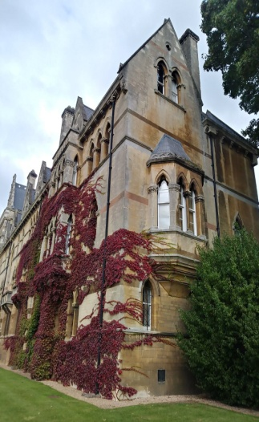
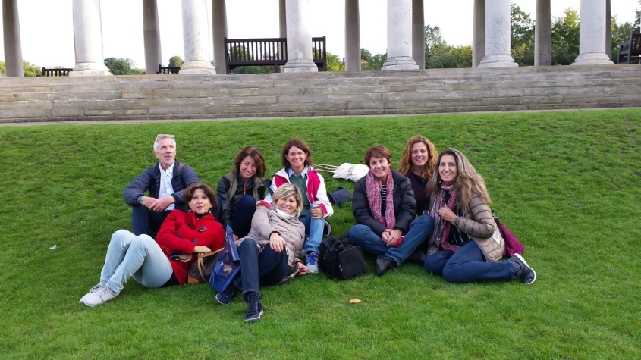
We visited Oxford and Canterbury, famous for their historical,artistic and cultural heritage.
These excursions gave us the opportunity to
have a lesson in
“open-air
museums!”

